Slide 1
P2654/P1687.1 Unified Concepts Analysis
Bradford G. Van Treuren 23 March 2021

Slide 2
Study Ground Rules

Slide 3
Goals
Define a descriptive standard that coordinates test standards using a unified process
Ensure standard is scalable to support IP, device, board, sub-system and system level architectures, including System-on-Chip.
Support EDA tooling as well as embedded run-time environments
Support off-line generation and interactive access to instrumentation from possibly dissimilar test standards
Support bridging technology between test standards to transmit test data to the target instrumentation
Need to be able to support injection of stimulus from a DSL language (e.g., SVF, PDL) player at appropriate levels to support off-line generated test data applied to the sub-tree
Support for logging message transactions allowing for formatting as test protocol DSL files

Slide 4
Decisions
Describe behavioral and not structural aspects of the design
Use callback methods to define the behavior of a circuit
Allow integration with retargeter technology when available to generate test data
Defined process must also support cases where a retargeter is not present

Slide 5
Observations
IEEE 1687 ICL is overkill for use given it defines the pseudo structure of the circuit
Michele’s Simplified ICL Tree (SIT) describes the minimal necessary information from ICL
ICL defines a set of core building blocks (base elements), which have very well defined behaviors: Networks, MUX’s, ScanRegister, DataRegister, AccessLink, eTAP’s
Overlapping context dependencies (PDL, SIT, Protobuf, Callbacks)
Model Node and DSL Injection are competing interfaces to the software model
May be viewed as a 3-D tree model with context branches in different directions for a single Model Node

Slide 6
Analysis Insights Revisited P2654 STAM WG Meeting #88

Slide 7
Transformation and RVF-to-RVF interface boundaries Reflecting on Black Box and fully described cases
Leaf descriptions (hand-off from other standards) and not hierarchical transformational descriptions
Described and not prescribed
Describes behavior of use and not implementation of design
May be an obfuscation of the behavior
STAM describes sequence of events and not necessarily the timing of the events (not cycle based).
Allow IEEE 1149.1-2013/1687 PDL event cycle compatibility
1149.1-2013 BSDL extensions for TDR path descriptions
1687 ICL for timing and access to TDR (Scan Registers) and Data Registers (Parallel Instrument Registers)
Defines what has to be passed via RVF to the P2654 tool flow
STAM is agnostic to purpose of data and only required to transfer data at the right time in the right sequence
STAM is agnostic to what standard (official or ad hoc) are being used at the leaf nodes of the P2654 model

Slide 8
Transformation and RVF-to-RVF interface boundaries Message Transformation
Brad’s demo packets
Universal Identifier – UID (unique for an assembly instance – a node in the topology tree slide 24)
Command – String
Payload – binary data formatting parameters and data required for a callback
There are 2 aspects for the packet
That which is specific to a tool implementation (not part of the standard) – UID
That which is descriptive and not prescriptive as part of the interface: Callback name, Callback parameters, Data
UID across physical hardware boundaries (system to sub-system) may require a way of exporting the remote UID and aliased for the local model to use. Does this make UID required for the standard?

Slide 9
Transformation and RVF-to-RVF interface boundaries Message Transformation
Brad’s simplified transformation engine diagram was shown (see slide 36)
Ideally, looking at Jeff Rearick’s gRPC description slides from his 1687.1 demo would be helpful
Need to look at Strategy and Plug-in Software Design Patterns (google search for these for details)
Strategy for specifying Transformation API
Plug-in for extension to external modules/libraries

Slide 10
Simplified ICL Tree (SIT)† Revisited & Issues
†Simplified ICL Tree.pdf, Michele Portolan, September 2020

Slide 11
Simplified ICL Tree (SIT) Revisited: Base Assumptions
HW is standard-compliant
Verified by designers
No need to describe «how it works»!
«Simplified»
Describe base elements and their relationship
Comes before RTL : hierarchical description
«How to use it»
«Tree »
Acyclic graph : no “shooting in the foot”
Straightforward parsing
Easy algorithmic
NB: This Condition can be relaxed
Simplified ICL Tree.pdf, Michele Portolan, September 2020, Slide 3

Slide 12
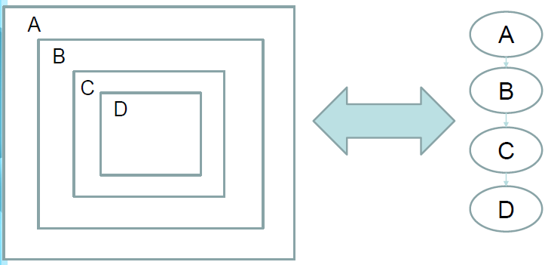
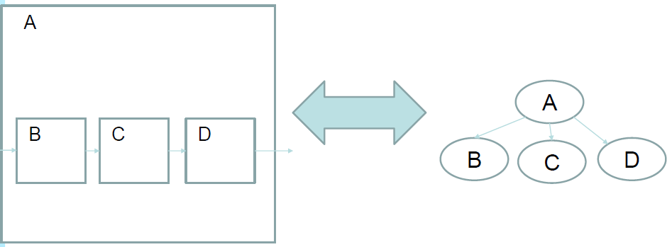
Simplified ICL Tree (SIT) Revisited: Base Representations
Representation of a chain
Representation of a hierarchy
Simplified ICL Tree.pdf, Michele Portolan, September 2020, Slides 4 & 5

Slide 13
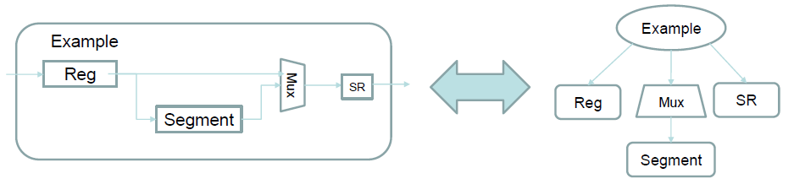
Simplified ICL Tree (SIT) Revisited: From Connection to Hierarchy
Pictorially
Text Description
1)CHAIN Example
2){
3) REGISTER Reg8 Bypass: "0x00"
4) LINKER Mux Binary SR 1
5) ( REGISTER Segment 12 Bypass: "0xABC" )
6) REGISTER SR 1 Bypass: "0x0"
7)}
Simplified ICL Tree.pdf, Michele Portolan, September 2020, Slide 6

Slide 14
Simplified ICL Tree (SIT) Revisited: SIT Building Blocks
Structural Components
CHAIN (Hierarchical Component)
Accolades “{“ and “}” (Define sibling components)
REGISTER
LINKER
Accolades “(“ and “)” (Define dynamically selectable sub-components)
Protocol Components
ACCESS_INTERFACE (Connection to outside world from structural component)
TRANSLATOR (For protocol to protocol transformation)
Simplified ICL Tree.pdf, Michele Portolan, September 2020, Slides 7, 9, 11, 15 & 18

Slide 15
Simplified ICL Tree (SIT) Issues
Nodes in tree represent Structural or Protocol components
Structural nodes define topology expecting to be retargeted
Once out of retargeting domain, only Access_Interface or Translator nodes allowed at higher levels
This does not support P2654 hierarchies needing to support structural elements, such as LINKER nodes managing board chains
iApply triggers retargeting to produce RVF for a single Access_Interface
Assume a retargeter will be available for lower levels of the topology tree to provide synchronization mechanism (assume PDL will be basis for application code)
Assume RVF message is sufficient synchronization trigger for Translator and Access_Interface nodes
Bad assumption that RVF message is sufficient for synchronization in P2654 where synchronization between retargeting environments is required (e.g., SERDES test)
Not all environments will have a retargeter present

Slide 16
Simplified ICL Tree (SIT) Issues
Protocol nodes exist outside retargeter context
Access_Interface “protocol” argument represents “intent” for a node
RVF used as data interface mechanism between nodes – structural and protocol nodes
BSR associated with multiple entries in path selector table for LINKER, but only one value per child allowed presently
Inconsistent representation of entity types (violates most DSL best common practices http://voelter.de/data/pub/DSLBestPractices-2011Update.pdf)
Too many assumptions about how behavior is resolved further exacerbated by “MACRO” definition simplifications that compound the assumptions
Context specific parameterization uses freeform single string container

Slide 17
Alternate Architectural Concepts
Messaging with Callbacks is the Key

Slide 18
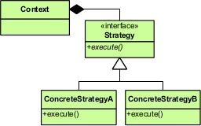
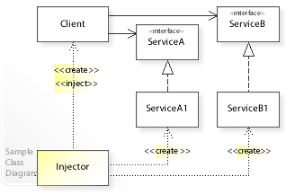
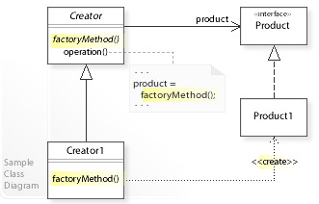
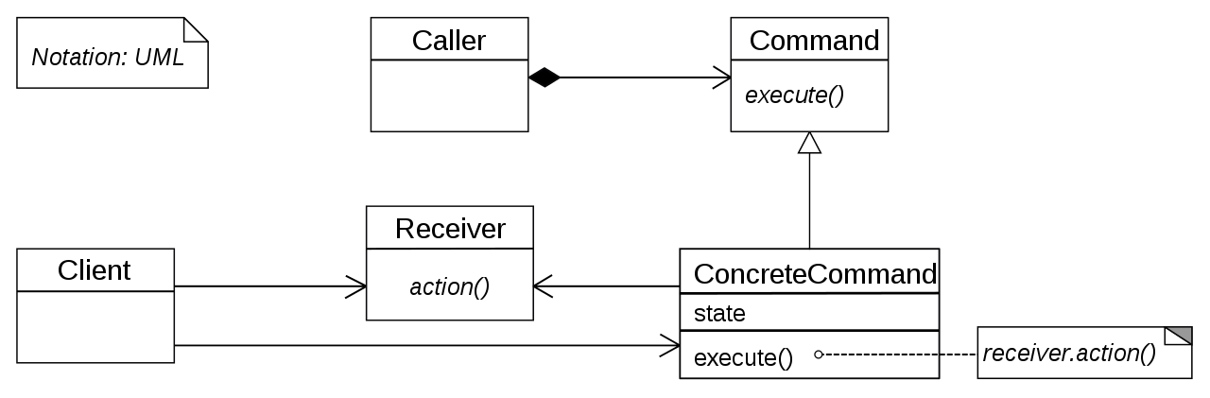
Key Design Patterns to Consider
Strategy Pattern https://en.wikipedia.org/wiki/Strategy_pattern
Dependency Injection Pattern https://en.wikipedia.org/wiki/Dependency_injection
Factory Method Pattern https://en.wikipedia.org/wiki/Factory_method_pattern
Command Pattern https://en.wikipedia.org/wiki/Command_pattern

Slide 19
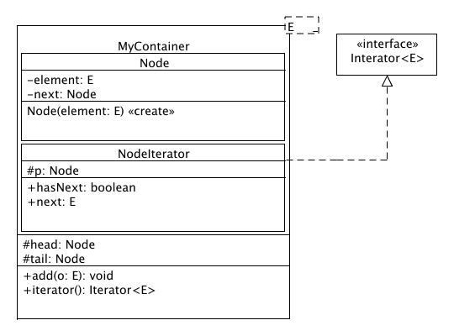
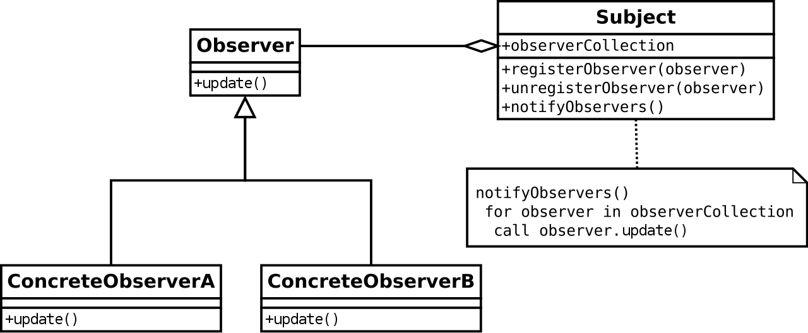
Key Design Patterns to Consider
Container Pattern http://best-practice-software-engineering.ifs.tuwien.ac.at/patterns/container.html
Observer Pattern https://en.wikipedia.org/wiki/Observer_pattern

Slide 20
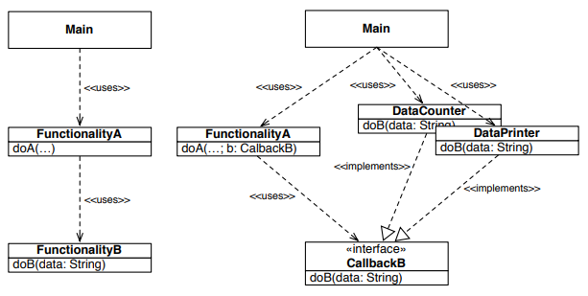
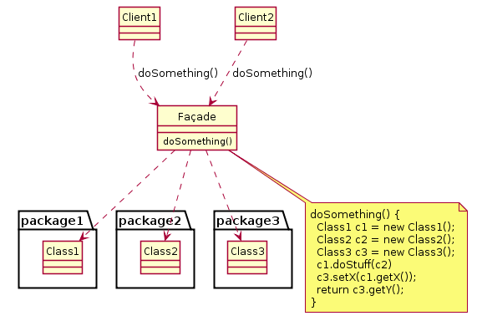
Key Design Patterns to Consider
Callback Pattern https://www.win.tue.nl/~wstomv/edu/2ip15/downloads/Series_04/callbacks.pdf
Façade Pattern https://en.wikipedia.org/wiki/Facade_pattern

Slide 21
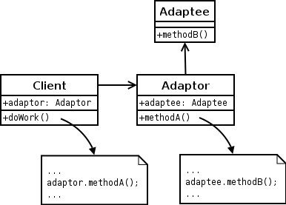
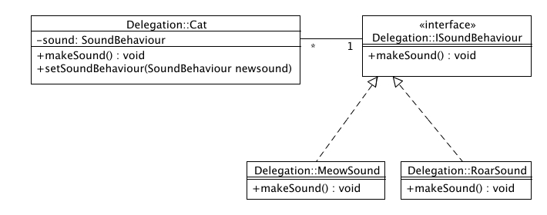
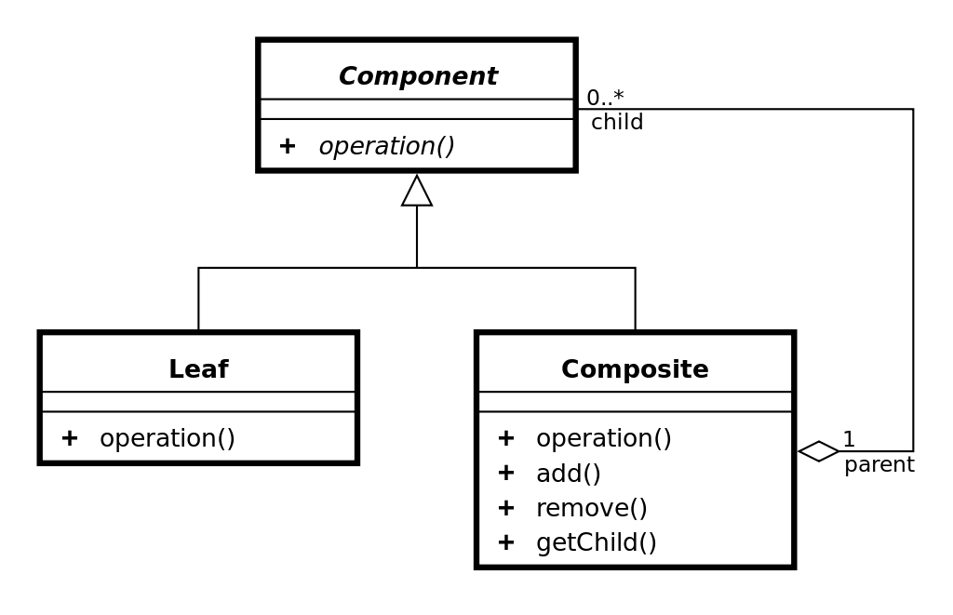
Key Design Patterns to Consider
Adapter Pattern https://en.wikipedia.org/wiki/Adapter_pattern
Delegation Pattern http://best-practice-software-engineering.ifs.tuwien.ac.at/patterns/delegation.html
Composite Pattern https://en.wikipedia.org/wiki/Composite_pattern

Slide 22
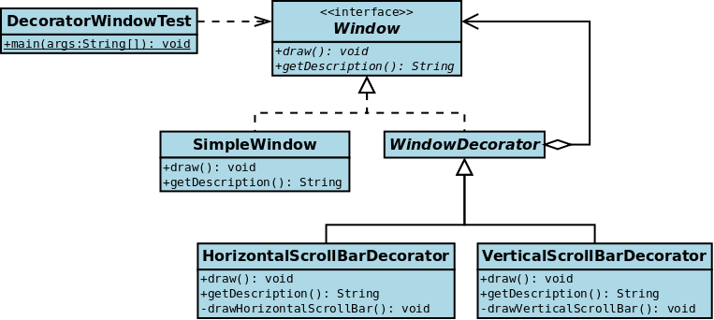
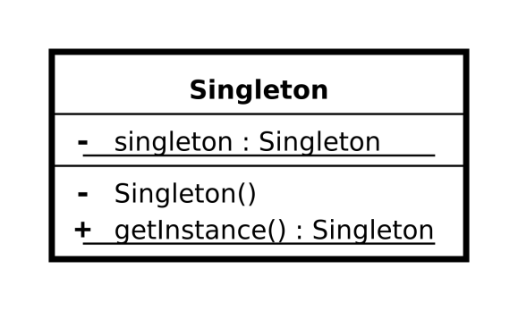
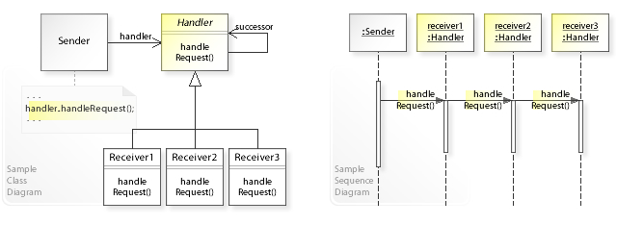
Key Design Patterns to Consider
Singleton Pattern https://en.wikipedia.org/wiki/Singleton_pattern
Chain-of-Responsibility (Visitor) Pattern https://en.wikipedia.org/wiki/Chain-of-responsibility_pattern
Decorator Pattern https://en.wikipedia.org/wiki/Decorator_pattern

Slide 23
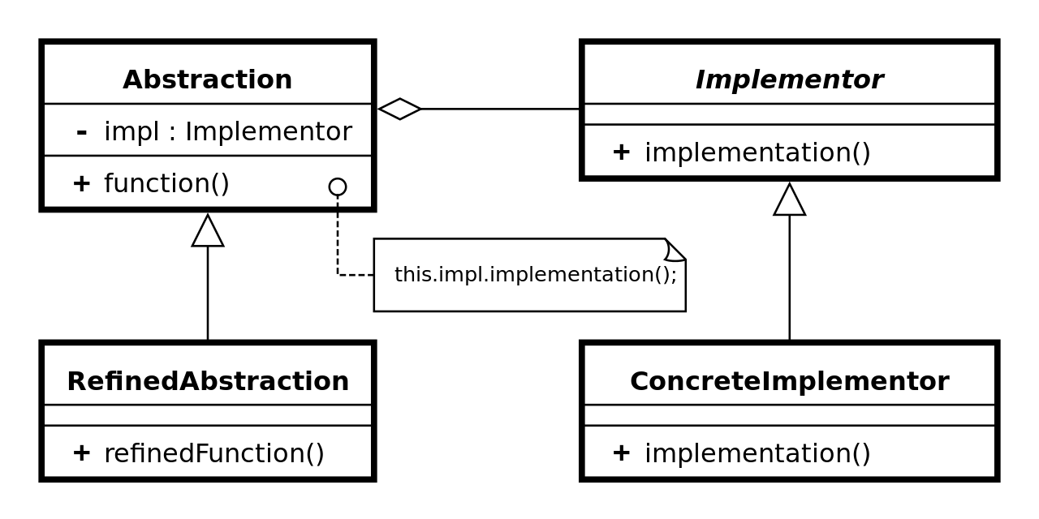
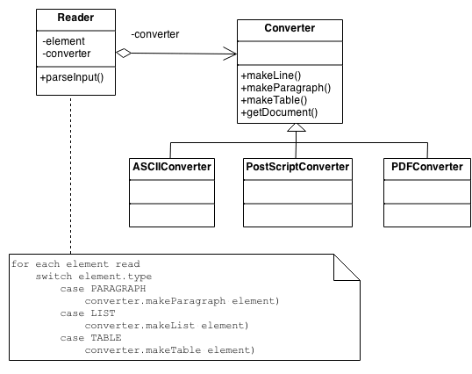
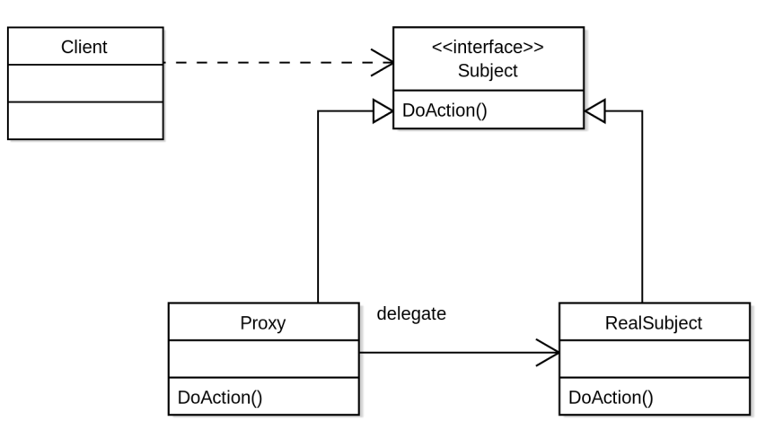
Key Design Patterns to Consider
Bridge Pattern https://en.wikipedia.org/wiki/Bridge_pattern
Builder Pattern https://sourcemaking.com/design_patterns/builder
Proxy Pattern https://en.wikipedia.org/wiki/Proxy_pattern

Slide 24
P2654Board1 Design Example
Topology modeled as a hierarchical tree
Ordered list of children at same branch level
Resolve synchronization using depth first traversal
Transform strategy defining Node behavior
Nodes connected by AccessInterface messages (edges in graph)
Use a form of Simplified ICL Tree Element Description to define Node configuration and strategy parameterization
JTAGControllerAssembly
JTAGChain
TAP
IR
ScanMux
BYPASS
BSR

Slide 25
Generalized P2654 SW Model
Modeling part of Application
Top Level (Where SW model meets HW)
gRPC_TOP
SPI_to_I2C Bridge
ModelPointProxy (RPC Extension adapter)
ModelPoint Proxy (RPC Extension adapter)
JTAG_TOP
I2C_TOP
GPIO_TOP
SPI_TOP
ModelPoint (adapter)
ModelPoint (adapter)
ModelPoint (adapter)
Transformation Node (e.g., LINKER, SCANMUX, BRIDGE, etc.)
ModelPoint (adapter)
Sub-Assembly (Top Level)
I2C Model
Transformation Node (e.g., LINKER, SCANMUX, BRIDGE, etc.)
Sub-Assembly (Top Level)
I2C Model
GPIO Model
SPI Model
Transformation Node
(JTAG2GPIO Bridge)
ModelPoint (adapter)
ModelPoint
(adapter)
ModelPoint (adapter)
ModelPoint (adapter)
ModelPoint (adapter)
Transformation Node
(JTAG2I2C Bridge)
ModelPoint (adapter)
Custom Model
JTAG Model
SCAN Model
ScanReg Model
DataReg Model
ModelPoint (adapter)
I2C Model
GPIO Model
Notes:
ModelPoint (adapter) is the conversion point between different tool domains.

Slide 26
Model Node Interfaces
Model Node
Injection Strategy
Host
Host/Client AccessInterface
Injection Interface
Debug Interface
Transformation Interface
Debug Strategy
Model Node
Transformation Strategy
Host/Client AccessInterface
TestInjectionInterface
Model Node
Model Node
Injection Node
Injection Node
Clients
o o o
o o o
Notes:
Model Node: Tree representation of the modeling for the entity at the current level (main representation or entry point to the entity data and representation)
Injection Node: Modules used to alter the state of the Model Node entity. This could be an interface to the application software or to a DSL player that is used to play back off-line generated tests.
Transformation Strategy: The callback implementation for the Transformation Engine of this Model Node. The purpose of the Transformation Strategy is to transform messages arriving at either the Client AccessInterface or the Test InjectionInterface into a set of equivalent messages for the Host AccessInterface domain.
Debug Strategy: The monitoring implementation for diagnosing or logging message events processed by the Model Node.
Host/Client AccessInterface: Communications interface between a Client (lower or rightmost) Node and a Host (upper or leftmost) Node where RVF messages are passed between domain Nodes.
TestInjectionInterface: Communications interface between a test injection source seeking to alter the state of the Model Node and the Model Node. RVF messages consistent with the Host AccessInterface protocol is used to alter the state of the Model Node. Alterations are translated and passed to Client Model Nodes to synchronize the alterations of the Client tree with the alteration requests by the Injection Node.
Transformation Interface: Communications interface between the Model Node software and the Transformation Strategy callback methods.
Injection Interface: Communications interface between the Model Node software and the transformation callbacks used to translate the injection requests into update messages for the Client Model Nodes of the Client tree.
Debug Interface: Communications interface used to monitor what messages are processed on the Model Node interfaces.

Slide 27
Model Node Patterns
Model Node
Injection Strategy
Host
Composite Pattern, Adapter Pattern
Strategy Pattern, Command Pattern
Strategy Pattern, Command Pattern
Strategy Pattern, Command Pattern
Debug Strategy
Model Node
Transformation Strategy
Composite Pattern, Adapter Pattern
Composite Pattern, Adapter Pattern
Model Node
Model Node
Injection Node
Injection Node
Clients
o o o
o o o
Notes:
Model Node: Tree representation of the modeling for the entity at the current level (main representation or entry point to the entity data and representation)
Injection Node: Modules used to alter the state of the Model Node entity. This could be an interface to the application software or to a DSL player that is used to play back off-line generated tests.
Transformation Strategy: The callback implementation for the Transformation Engine of this Model Node. The purpose of the Transformation Strategy is to transform messages arriving at either the Client AccessInterface or the Test InjectionInterface into a set of equivalent messages for the Host AccessInterface domain.
Debug Strategy: The monitoring implementation for diagnosing or logging message events processed by the Model Node.
Host/Client AccessInterface: Communications interface between a Client (lower or rightmost) Node and a Host (upper or leftmost) Node where RVF messages are passed between domain Nodes.
TestInjectionInterface: Communications interface between a test injection source seeking to alter the state of the Model Node and the Model Node. RVF messages consistent with the Host AccessInterface protocol is used to alter the state of the Model Node. Alterations are translated and passed to Client Model Nodes to synchronize the alterations of the Client tree with the alteration requests by the Injection Node.
Transformation Interface: Communications interface between the Model Node software and the Transformation Strategy callback methods.
Injection Interface: Communications interface between the Model Node software and the transformation callbacks used to translate the injection requests into update messages for the Client Model Nodes of the Client tree.
Debug Interface: Communications interface used to monitor what messages are processed on the Model Node interfaces.

Slide 28
Model Node Patterns
Transformation Engine implements Delegation Pattern to pass RVF messages from AccessInterfaces to Transform Strategy or Injection Strategy classes
Transform Strategy and Injection Strategy implements Façade or Wrapper Pattern when composing callback methods – both built-in and external library callbacks
RVF messages implement the Command Pattern to select the Strategy Pattern to use for the transformation action
ModelPoint nodes implement the Adapter Pattern and/or Bridge Pattern between P2654 and tooling

Slide 29
Description of Flow

Slide 30
Data Flow Example
iWrite Value of IR is updated to the value of 0x00000001 (Select BSR TDR with PRELOAD)
iRead value of IR is not selected as it is not needed
iApply is called
IR Node sends SHIFT-UPDATE (SU) message to TAP Node requesting value 0x00000001 be applied
TAP Node transforms message into SIR message with TDI 0x00000001with a MASK of 0x00000000 and TDO 0x00000000 and sends request to JTAGChain
JTAGChain retargets data into overall chain and creates a new SIR message request to JTAGControllerAssembly
JTAGControllerAssembly sends data and operation to JTAGController device driver to synchronize hardware
JTAGControllerAssembly
JTAGChain
TAP
IR
ScanMux
BYPASS
BSR

Slide 31
Data Flow Example
JTAGController driver returns data captured from the hardware scan chain to JTAGControllerAssembly
JTAGControllerAssembly sends response message with capture data to JTAGChain
JTAGChain inverse transforms response message into child scoped response messages and sends them to children
TAP inverse transforms response message into SU response message and sends it to IR to update and complete the iWrite/iApply operation
JTAGControllerAssembly
JTAGChain
TAP
IR
ScanMux
BYPASS
BSR

Slide 32
Data Flow Example
iWrite value to BSR of 0x80000000
iRead value of 0x00000001 is applied to BSR
iApply is called
BSR sends CSU message with update(0x80000000) and capture(0x00000001) request to ScanMux Node
ScanMux sends CSU message request to TAP
TAP transforms CSU message into an SDR message request with TDI 0x8000000, TDO 0x00000001 and MASK 0xFFFFFFFF
TAP sends requested SDR message to JTAGChain
JTAGChain retargets request with other requests from other children and creates SDR request that it sends to JTAGControllerAssembly
JTAGControllerAssembly sends SDR operation to the JTAGController driver to synchronize the hardware
JTAGControllerAssembly
JTAGChain
TAP
IR
ScanMux
BYPASS
BSR

Slide 33
Data Flow Example
JTAGController driver returns the data captured by the scan chain to JTAGControllerAssembly
JTAGControllereAssembly creates an SDR response message with the captured data and sends it the JTAGChain
JTAGChain inverse transforms the message into child context SDR response messages and sends them to the children nodes
TAP inverse transforms the SDR response into a CSU response message and sends it to ScanMux
ScanMux sends CSU response message to BSR
BSR updates its internal capture state to the value from the CSU response message
JTAGControllerAssembly
JTAGChain
TAP
IR
ScanMux
BYPASS
BSR

Slide 34
Model Node Interfaces
Model Node
Injection Strategy
Host
Client/Host AccessInterface
Injection Interface
Debug Interface
Transformation Interface
Debug Strategy
Model Node
Transformation Strategy
Host/Client AccessInterface
TestInjectionInterface
Model Node
Model Node
Injection Node
Injection Node
Clients
o o o
o o o
Notes:
Model Node: Tree representation of the modeling for the entity at the current level (main representation or entry point to the entity data and representation)
Injection Node: Modules used to alter the state of the Model Node entity. This could be an interface to the application software or to a DSL player that is used to play back off-line generated tests.
Transformation Strategy: The callback implementation for the Transformation Engine of this Model Node. The purpose of the Transformation Strategy is to transform messages arriving at either the Client AccessInterface or the Test InjectionInterface into a set of equivalent messages for the Host AccessInterface domain.
Debug Strategy: The monitoring implementation for diagnosing or logging message events processed by the Model Node.
Host/Client AccessInterface: Communications interface between a Client (lower or rightmost) Node and a Host (upper or leftmost) Node where RVF messages are passed between domain Nodes.
TestInjectionInterface: Communications interface between a test injection source seeking to alter the state of the Model Node and the Model Node. RVF messages consistent with the Host AccessInterface protocol is used to alter the state of the Model Node. Alterations are translated and passed to Client Model Nodes to synchronize the alterations of the Client tree with the alteration requests by the Injection Node.
Transformation Interface: Communications interface between the Model Node software and the Transformation Strategy callback methods.
Injection Interface: Communications interface between the Model Node software and the transformation callbacks used to translate the injection requests into update messages for the Client Model Nodes of the Client tree.
Debug Interface: Communications interface used to monitor what messages are processed on the Model Node interfaces.

Slide 35
Transformation Flow
A Request message is received by the Host Interface and needs to be transformed into a set of Client side messages to the next higher level
Message is handed off to the Transform Strategy for processing
Client requests are queued and sent to next level one-by-one
Upper levels process requests and return responses for each message
Transform Strategy inverse transforms responses into Host side response messages
Transform Strategy sends responses to children of the host interface

Slide 36
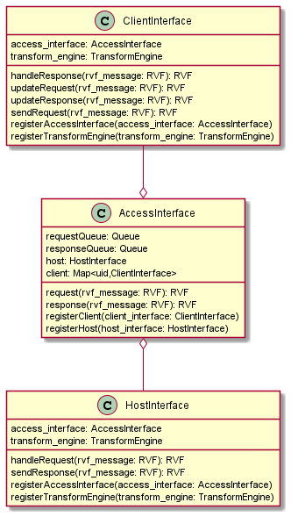
Simplified AccessInterface and Node Diagram
Abstracts the connections between Client/Host
Standardizes the communications interface
Routes messages between Client/Host and Host/Client
RVF agnostic
Buffer message groups of same context
Not transformation mechanism
Not router to handler callback (Client/Host Interfaces are)
Not synchronizing agent for model (transform vs. retarget motive)
(Model Node)
(Model Node)
Transformations in P2654 are nothing more than a specialized Transformation Engine that may or may not be P1687.1 compliant
CLIENT INTERFACE
TRANSFORM ENGINE
HOST INTERFACE
Deliver <= Route <= Queue <= Request
CLIENT INTERFACE
TRANSFORM ENGINE
HOST INTERFACE
REQUEST
RESPONSE
Response => Queue => Route => Deliver
ACCESS INTERFACE (edges of graph)

Slide 37
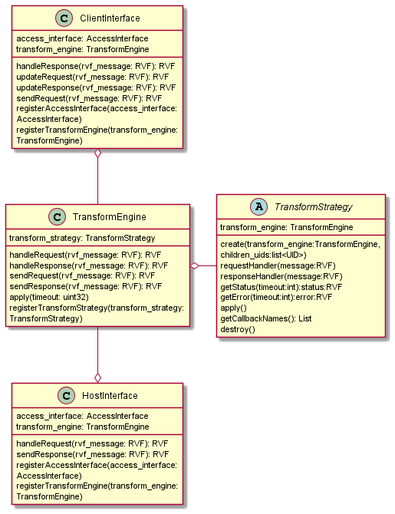
Simplified Node Diagram and Transform Strategy
CLIENT INTERFACE
Transformation Interface
TRANSFORMATION ENGINE
TRANSFORM STRATEGY (CALLBACK INTERFACE FAÇADE/ WRAPPER)
handleResponse
sendRequest
getStatus
getError
sendResponse
handleRequest
HOST INTERFACE

Slide 38
Simplified Node and Transform Strategy
TransformEngine abstracts the connections between Client/Host and the underlying TransformStrategy
TransformEngine standardizes the communications interface between Host/Client and TransformStrategy
RVF agnostic
TransformEngine is synchronizing agent for model (apply)
TransformStrategy wrapper for protobuffer callbacks
TransformStrategy single point of entry for all callbacks (see handlers)
TransformEngine monitors all messages passed between interfaces (See DebugStrategy)
CLIENT INTERFACE
Transformation Interface
TRANSFORMATION ENGINE
TRANSFORM STRATEGY (CALLBACK INTERFACE FAÇADE/ WRAPPER)
handleResponse
sendRequest
getStatus
apply
getError
sendResponse
handleRequest
HOST INTERFACE

Slide 39
Built-in Strategy
Built-in implements special “service” functions from protoc compiled in same programming language as system model
Direct call to callback functions from TransformStrategy
Used mainly for standardized primitive elements defined by the standard (e.g., SIB, LINKER, MUX)
CLIENT INTERFACE
Transformation Interface
TRANSFORMATION ENGINE
TRANSFORM STRATEGY (CALLBACK INTERFACE FAÇADE/ WRAPPER)
Built-in TransformStrategy
handleResponse
sendRequest
getStatus
apply
getError
sendResponse
handleRequest
HOST INTERFACE

Slide 40
C/C++ Library Extension Strategy
Leverages protobuffer programming language to support model language and C/C++
Direct call to callback functions from TransformStrategy
Service functions from protoc compile in C or C++ code
SWIG generated or hand crafted to adapt model code to C/C++ callbacks
CLIENT INTERFACE
Transformation Interface
SWIG + Callback Library
TRANSFORMATION ENGINE
TRANSFORM STRATEGY (CALLBACK INTERFACE FAÇADE/
WRAPPER)
Transform Adapter
Extension TransformStrategy
handleResponse
sendRequest
getStatus
apply
getError
sendResponse
handleRequest
Node language decoders from message to callback
HOST INTERFACE

Slide 41
Model Node Interfaces
Model Node
Injection Strategy
Host
Host/Client AccessInterface
Injection Interface
Debug Interface
Transformation Interface
Debug Strategy
Model Node
Transformation Strategy
Host/Client AccessInterface
TestInjectionInterface
Model Node
Model Node
Injection Node
Injection Node
Clients
o o o
o o o
Notes:
Model Node: Tree representation of the modeling for the entity at the current level (main representation or entry point to the entity data and representation)
Injection Node: Modules used to alter the state of the Model Node entity. This could be an interface to the application software or to a DSL player that is used to play back off-line generated tests.
Transformation Strategy: The callback implementation for the Transformation Engine of this Model Node. The purpose of the Transformation Strategy is to transform messages arriving at either the Client AccessInterface or the Test InjectionInterface into a set of equivalent messages for the Host AccessInterface domain.
Debug Strategy: The monitoring implementation for diagnosing or logging message events processed by the Model Node.
Host/Client AccessInterface: Communications interface between a Client (lower or rightmost) Node and a Host (upper or leftmost) Node where RVF messages are passed between domain Nodes.
TestInjectionInterface: Communications interface between a test injection source seeking to alter the state of the Model Node and the Model Node. RVF messages consistent with the Host AccessInterface protocol is used to alter the state of the Model Node. Alterations are translated and passed to Client Model Nodes to synchronize the alterations of the Client tree with the alteration requests by the Injection Node.
Transformation Interface: Communications interface between the Model Node software and the Transformation Strategy callback methods.
Injection Interface: Communications interface between the Model Node software and the transformation callbacks used to translate the injection requests into update messages for the Client Model Nodes of the Client tree.
Debug Interface: Communications interface used to monitor what messages are processed on the Model Node interfaces.

Slide 42
Injection Flow
Injection Node represents data injection sources (e.g., System Application, SVF Player, PDL Player)
Parallel source of messages for Model Node
Injection Node passes messages in the Client Interface context
Injection Strategy responsible for decomposing message into update messages for children of the Model Node to synchronize state changes in the hardware based on injection messages with the software model
Transformation Engine is responsible for routing injected Request messages and Client Response messages to the Injection Strategy when processing injected data. Otherwise, the Transformation Engine routes messages to and from the Transformation Strategy

Slide 43
Stimulus Injection Process
Injection Node sends request for Client Interface context to Injection Strategy
Injection Strategy verifies and forwards message to Client Interface via TransformEngine
Injection Strategy transforms request into updateRequests for children of the Host Interface
Injection Strategy handles response from Client Interface
Injection Strategy passed Client response data to Injection Node
Client Interface
Injection Interface
Transform Engine
TestInjectionInterface
handleResponse
sendRequest
Injection Node
handleRequest
Injection Strategy
TestInjectionInterface
apply
sendResponse
updateResponse
updateRequest
Host Interface

Slide 44
Stimulus Injection Process
Injection Strategy send an inverse transformed message for the children of Host Interface to update child states
Injection Strategy follows the same implementation/extension mechanism used for Transform Strategy
Client Interface
Injection Interface
Transform Engine
TestInjectionInterface
handleResponse
sendRequest
Injection Node
handleRequest
Injection Strategy
TestInjectionInterface
apply
sendResponse
updateResponse
updateRequest
Host Interface

Slide 45
Model Node Interfaces
Model Node
Injection Strategy
Host
Host/Client AccessInterface
Injection Interface
Debug Interface
Transformation Interface
Debug Strategy
Model Node
Transformation Strategy
Host/Client AccessInterface
TestInjectionInterface
Model Node
Model Node
Injection Node
Injection Node
Clients
o o o
o o o
Notes:
Model Node: Tree representation of the modeling for the entity at the current level (main representation or entry point to the entity data and representation)
Injection Node: Modules used to alter the state of the Model Node entity. This could be an interface to the application software or to a DSL player that is used to play back off-line generated tests.
Transformation Strategy: The callback implementation for the Transformation Engine of this Model Node. The purpose of the Transformation Strategy is to transform messages arriving at either the Client AccessInterface or the Test InjectionInterface into a set of equivalent messages for the Host AccessInterface domain.
Debug Strategy: The monitoring implementation for diagnosing or logging message events processed by the Model Node.
Host/Client AccessInterface: Communications interface between a Client (lower or rightmost) Node and a Host (upper or leftmost) Node where RVF messages are passed between domain Nodes.
TestInjectionInterface: Communications interface between a test injection source seeking to alter the state of the Model Node and the Model Node. RVF messages consistent with the Host AccessInterface protocol is used to alter the state of the Model Node. Alterations are translated and passed to Client Model Nodes to synchronize the alterations of the Client tree with the alteration requests by the Injection Node.
Transformation Interface: Communications interface between the Model Node software and the Transformation Strategy callback methods.
Injection Interface: Communications interface between the Model Node software and the transformation callbacks used to translate the injection requests into update messages for the Client Model Nodes of the Client tree.
Debug Interface: Communications interface used to monitor what messages are processed on the Model Node interfaces.

Slide 46
Debug Flow
Provides a way to monitor the messages passing through the Model Node
May be used to record vector information in DSL formats like SVF if desired
Transform Engine routes copies of messages from Client/Host Interfaces, Injection Strategy, and Transform Strategy to the Debug Strategy

Slide 47
Debug Recording Strategy
Debug Strategy used to log messages passing through the Model Node
Transform Engine extracts RVF messages from Host/Client Interfaces, Injection Interface, Transform Strategy, and Injection Strategy
Debug Strategy follows the same implementation/extension mechanism used for Transform Strategy
Debug Interface
Transform Engine
handleRequest
sendRequest
handleResponse
Debug Strategy
sendResponse
updateRequest
updateResponse
apply

Slide 48
Integrating With Tooling
ModelPoint Adapter Between System Model and External Tools

Slide 49
Generalized P2654 SW Model
Modeling part of Application
Top Level (Where SW model meets HW)
gRPC_TOP
SPI_to_I2C Bridge
ModelPointProxy (RPC Extension adapter)
ModelPoint Proxy (RPC Extension adapter)
JTAG_TOP
I2C_TOP
GPIO_TOP
SPI_TOP
ModelPoint (adapter)
ModelPoint (adapter)
ModelPoint (adapter)
Transformation Node (e.g., LINKER, SCANMUX, BRIDGE, etc.)
ModelPoint (adapter)
Sub-Assembly (Top Level)
I2C Model
Transformation Node (e.g., LINKER, SCANMUX, BRIDGE, etc.)
Sub-Assembly (Top Level)
I2C Model
GPIO Model
SPI Model
Transformation Node
(JTAG2GPIO Bridge)
ModelPoint (adapter)
ModelPoint
(adapter)
ModelPoint (adapter)
ModelPoint (adapter)
ModelPoint (adapter)
Transformation Node
(JTAG2I2C Bridge)
ModelPoint (adapter)
Custom Model
JTAG Model
SCAN Model
ScanReg Model
DataReg Model
ModelPoint (adapter)
I2C Model
GPIO Model
Notes:
ModelPoint (adapter) is the conversion point between different tool domains.

Slide 50
Generalized P1687.1 SW Model
Modeling part of Application
Top Level (Where SW model meets HW)
P2654
JTAG_TOP
I2C_TOP
SPI_TOP
Transformation Node (JTAGChain)
Transformation Node (I2CChain)
Transformation Node (SPIChain)
Transformation Node (I2CTE_DPIC)
Transformation Node (SPITE_DPIC)
ModelPoint (adapter)
P1687.1
Transformation Node (TransformEngine)
Transformation Node (TransformEngine)
JTAG/1687 Retargeter
SCAN/1687 Retargeter
ModelPoint (adapter)
SCAN/1687 Retargeter
ModelPoint (adapter)

Slide 51
Strategy to Bridge Between P2654 and non-P2654 Domains
ModelPoint (adapter) is a non-visible node in the topology path
ModelPoint (adapter) translates non-P2654 grammars to P2654 grammar
Translation interface between external tooling and the software model message scheme
Ensures valid RVF messages to the software model
Provides hook for external model tooling for registers or devices to interact with the model tree
Provides hook for simulation tooling for registers or devices for verification comparison of simulation and hardware
ModelPoint
(adapter)
ModelPoint
(adapter)
ModelPoint
(adapter)
Custom Model
Device EDA Tool
SCAN Model
ModelPoint
(adapter)
ModelPoint
(adapter)
SPI Message Based Tooling
I²C Message Based Tooling
ModelPoint
(adapter)
ModelPoint
(adapter)
ModelPoint
(adapter)
JTAG Model
ScanReg SIM Model
DataReg SIM Model
Notes:
Custom Model: Any modeling or tooling providing retargeting or vectors for specific level that does not conform to the P2654 RVF grammar specifications and messaging format defined by the native software model for that level.
Device EDA Tool: A communications interface with a device EDA tool that provides interactive vector information for a device interface that does not conform to the P2654 RVF grammar specifications and messaging format defined by the native software model for that level.
SCAN Model: A communications interface with tooling that provides vectors for an IEEE 1687 network branch at a given hierarchical level that does not conform to the P2654 RVF grammar specifications and messaging format defined by the native software model for that level. This could be an interface from the system model application to alter the state of a 1687 scan network.
IEEE 1687 Application PDL IF: The Application PDL Interface is communications interface with tooling that provides vectors for an IEEE 1687 network branch at a given hierarchical level that does not conform to the P2654 RVF grammar specifications and messaging format defined by the native software model for that level. This is used by interactive PDL applications.
IEEE 1149.1 Application PDL IF: The Application PDL Interface is communications interface with tooling that provides vectors for an IEEE 1149.1-2013 network branch at a given hierarchical level that does not conform to the P2654 RVF grammar specifications and messaging format defined by the native software model for that level. This is used by interactive PDL applications.
I²C Message Based Tooling: A communications interface with tooling that provides I2C commands for a specific network branch or device interface at a given hierarchical level that does not conform to the P2654 RVF grammar specifications and messaging format defined by the native software model for that level.
SVF Player + JTAG Model: A communications interface with tooling that provides vectors from an SVF Player and EDA tooling for an IEEE 1149.1 JTAG network branch or device at a given hierarchical level that does not conform to the P2654 RVF grammar specifications and messaging format defined by the native software model for that level.
ScanReg Model: An interface from the system model application used to alter the state of a particular ScanRegister in a 1687 network.
DataReg Model: An interface from the system model application used to alter the state of a particular DataRegister in a 1687 network.

Slide 52
Strategy to Bridge Between P2654 and non-P2654 Domains
ModelPoint (adapter) provides a standardized interface to remote sub-systems that provide hooks to extend the modeling of a system to lower levels of control
This hook may be gRPC services handling valid P2654 RVF messages
This hook may be messages defining commands to be issued to a remote application interface as string messages passed via a Telnet, SSH, Raw RS-232, USB, or Ethernet port between system and sub-system
Dotted box may be located on sub-system or virtualized as a representation of sub-system on the system
ModelPoint Proxy1 (RPC Extension adapter)
ModelPoint Proxy2 (RPC Extension adapter)
Sub-Assembly1 (Top Level)
Sub-Assembly2 (Top Level)

Slide 53
Use Case Examples
Flow Through ModelPoints, InjectionPoints, and Model Nodes

Slide 54
ModelPoint & InjectionPoint Example
RVF(“SDR“,32 , 0xdead0bad, 0x00000000) # WAIT for sync of model to complete
RVF(“SDR“,32 , 0xdead0bad, 0x00000000)
# WAIT for sync of model to complete
ModelPoint (adapter) handles messages from the 1687 Retargeter
The TestInjectionInterface handles messages coming from the application software
In this example, PDL strings are issued for the top level that are translated by the ModelPoint (adapter) into appropriate P2654 RVF messages with correct callback names required by a SCAN Network Node
After the retargeter is complete, the system application injects additional changes to the state of the model and thus the hardware
TAP
IR
SCANMUX
RVF(“CSU “,32 , 0xdead0bad, 0x00000000) # WAIT for sync of model to complete
RVF(“CSU “,32 , 0xdead0bad, 0x00000000)
# WAIT for sync of model to complete
1
SCAN Network
RVF(“CSU “,32 , 0xdead0bad, 0x00000000) # WAIT for sync of model to complete
RVF(“CSU “,32 , 0xdead0bad, 0x00000000)
# WAIT for sync of model to complete
2
TestInjectionInterface
ModelPoint
(adapter)
iScan top 32 –si 0xdead0bad –so 0x00000000 iApply
RVF(“CSU “,32 , 0xdead0bad, 0x00000000) # WAIT for sync of model to complete
RVF(“CSU “,32 , 0xdead0bad, 0x00000000)
# WAIT for sync of model to complete
1
2
1687 Retargeter
Application SCAN IF

Slide 55
InjectionPoint Example
RVF(“SIR“,32 , 0xdead0bad, 0x00000000) # WAIT for sync of model to complete
RVF(“SIR“,32 , 0xdead0bad, 0x00000000)
# WAIT for sync of model to complete
TAP
3
The TestInjectionInterface handles messages from the system application written to the Application PDL Player targeting the IR ScanReg
In this example, the application calls functions issued for the IR level that are appropriate P2654 RVF messages with correct callback names required by a ScanReg Node
The host for the TAP issues the SIR command Request
The IR Model Node is responsible for passing the messages from the PDL Player to the TAP
The TAP is responsible for transforming the CSU messages into appropriate SIR messages
1
IR (ScanReg)
SCANMUX
2
SCAN Network
TestInjectionInterface
3
RVF(“CSU “,32 , 0xdead0bad, 0x00000000) # WAIT for sync of model to complete
RVF(“CSU “,32 , 0xdead0bad, 0x00000000)
# WAIT for sync of model to complete
2
ModelPoint
(adapter)
PDL Player targeting IR
iWrite(0xdead0bad) iRead(0x00000000)
iApply() # WAIT for sync of model to complete
iWrite( 0xdead0bad)
iRead(0x00000000)
iApply()
# WAIT for sync of model to complete
1
1687 Retargeter

Slide 56
JTAGBoard1 SVF Example
SVF Player plays back one line at a time of the SVF file and transforms each statement into a JTAGChain message request
The JTAGChain passes that request to the JTAGControllerAssembly
Simultaneously, the JTAGController Injection Strategy transforms the request into CSU messages to the TAP to update the TAP tree request state
The TAP transforms the updateRequest into child updateRequests and passes them to the children nodes
The JTAGControllerAssembly sends the data to the JTAGController driver to synchronize the hardware
RVF(“SIR“, 8, 0x01, 0x00, 0x00) # WAIT for sync of model to complete
RVF(“SDR“,32 , 0x55555555, 0xAAAAAAAA, 0xFFFFFFFF)
# WAIT for sync of model to complete
JTAGControllerAssembly
TestInjectionInterface
JTAGChain
RVF(“SIR“, 8, 0x01, 0x00, 0x00) # WAIT for sync of model to complete
RVF(“SDR“,32 , 0x55555555, 0xAAAAAAAA, 0xFFFFFFFF)
# WAIT for sync of model to complete
RVF(“SIR“, 8, 0x01, 0x00, 0x00)
RVF(“SDR“,32 , 0x55555555, 0xAAAAAAAA, 0xFFFFFFFF)
TAP
SVF Player
RVF(“CSU “, 8, 0x01, 0x00, 0x00)
RVF(“CSU “,32 , 0x55555555, 0xAAAAAAAA, 0xFFFFFFFF)
SIR 8 TDI(01) MASK(00);
SDR 32 TDI(55555555) TDO(AAAAAAAA) MASK(FFFFFFFF);
RVF(“CSU “, 8, 0x01, 0x00, 0x00)
IR
ScanMux
RVF(“CSU “,32 , 0x55555555, 0xAAAAAAAA, 0xFFFFFFFF)
BYPASS
BSR

Slide 57
JTAGBoard1 SVF Example
JTAGController returns the capture values and passes them to JTAGControllerAssembly
JTAGControllerAssembly sends response to JTAGChain
JTAGChain sends response to SVF Player and updateResponse message to TAP
TAP sends updateResponse child messages to IR and ScanMux
ScanMux sends updateResponse child message to BSR
RVF(“SIR“, 8, 0x01) RVF(“SDR“,32 , 0xAAAAAAAA)
JTAGControllerAssembly
TestInjectionInterface
JTAGChain
RVF(“SIR“, 8, 0x01)
RVF(“SDR“,32 , 0xAAAAAAAA)
RVF(“SIR“, 8, 0x01)
RVF(“SDR“,32 , 0xAAAAAAAA)
TAP
SVF Player
RVF(“CSU “, 8, 0x01)
RVF(“CSU “,32 , 0xAAAAAAAA)
SIR 8 TDI(01) MASK(00);
SDR 32 TDI(55555555) TDO(AAAAAAAA) MASK(FFFFFFFF);
RVF(“CSU “, 8, 0x01)
IR
ScanMux
RVF(“CSU “,32 , 0xAAAAAAAA)
BYPASS
BSR

Slide 58
Message (RVF) Concepts
Google’s Open Source Protocol Buffers https://grpc.io/ https://github.com/protocolbuffers/protobuf/releases/tag/v3.14.0

Slide 59
Jeff Rearick’s gRPC/Protobuf Proposal Revisited

Slide 60
gRPC flow
User writes PDL test(s)
User writes protobuf
User writes service procedures
User writes client stubs
PDL
.proto
service procedures
client stubs
These are the deliverables for the standards
User runs retargeter
Compile protobuf
PDL0 at {SI,DI}
Pb2 file
Launch server code
Launch client code
transcript
Create one time
Use many times

Slide 61
Jeff’s gRPC Concept (Key Building Blocks)
.Proto
Server Code
Client Code

Slide 62
How Protobuf Helps Complete the Architecture

Slide 63
Synergism: Architecture & Protobuf?
Response Handler/ Request Publisher
Response Callbacks (non-blocking)
CLIENT INTERFACE
TRANSFORMATION ENGINE
Synchronization/ Shared Local Data
Request Handler/ Response Publisher
HOST INTERFACE
REQUEST
RESPONSE
Request Callbacks (non-blocking)
ACCESS INTERFACE
RVF Message (F1)
RVF Message (F2)
CLIENT INTERFACE
TRANSFORMATION ENGINE
HOST INTERFACE

Slide 64
Jeff’s gRPC Concept Revisited
.Proto
Server Code
Client Code
.Proto
Request Callbacks + PB2 Code
Application Code (Compiled PDL, etc)
.Proto
Response Callback + PB2 Code

Slide 65
Synergism
Response Handler/ Request Publisher
Response Callbacks (non-blocking)
Response Callback + PB2 Code
CLIENT INTERFACE
TRANSFORMATION ENGINE
Synchronization/ Shared Local Data
Request Handler/ Response Publisher
HOST INTERFACE
REQUEST
RESPONSE
Request Callbacks (non-blocking)
Request Callback + PB2 Code
ACCESS INTERFACE
.Proto + PB2
RVF Message (F1)
RVF Message (F2)
.Proto + PB2
CLIENT INTERFACE
TRANSFORMATION ENGINE
HOST INTERFACE

Slide 66
PB2 Code
Generated code for message serialization/deserialization
Generated code for message population and interrogation
Enforces and standardizes format types between languages
Generated code for target implementation language
Generated code for services if and only if protoc extension was written for target language and service type
May create generator templates for any kind of service type – not only for gRPC
Thus, may create generator for RVF callback services for TransformStrategy and InjectionStrategy definitions

Slide 67
Transform Strategy
Provides standardized extension interface between Transform Engine and protobuf callback code
Delegates selection of callback to handler implementation
Enforces message types conforming to .proto definitions for given callback declarations

Slide 68
Protobuf Implementation Concepts

Slide 69
Protobuf
Defines members of a message
Defines type of each member
Defines setter method for each member
Defines getter method for each member
Provides serialization/ deserialization for messages
Serialized representation as a binary array of data
Allows for nesting messages in other messages
Modular
Packages to specify namespaces
Import statement to import other message definitions
Extensible via custom modules for protoc
Support for new languages available using custom generators
Generates message code in a variety of languages
Generates service code in a variety of languages
Extensible service types with extensions to protoc

Slide 70
Protobuf Encapsulation vs. Inheritance
Encapsulation
Inheritance
Strategy used by IEEE 802.x
Each message context encapsulated as raw payload data in carrier message
Context routing of payload is done by decoding header members of message
Routing messages to context handler by carrier message
Requires a standardized means to serialize messages for pass by reference
Strategy used by Object Oriented Technology
Each message builds on a lesser semantic definition
Context messages are extensions of base message definitions that are specialized for the specific context
Routing messages to context handler by dedicated type fields in base context
Does not require serialization for pass by reference

Slide 71
Protobuf Encapsulation vs. Inheritance
Protobuf Encapsulation
Protobuf Inheritance
“bytes” type representational for payload
Payload type must be represented by a type field in wrapper message to be properly decoded by a common handler
Handler code uses field in master message to identify correct callback to pass payload (message) to
Each message is serialized into a raw packet string to be included in a wrapper message
A wrapper message is used to transmit payload message between client and host
Unique messages for each callback serialized into binary payload
Protobuf does not directly support inheritance, but does support composition
Protobuf composition exposes implementation (multi-level accessors)
Protobuf supports partial read of a message by a subset message of same structure
Handler code decodes header information of message by deserializing to a subset message
Requires each message to adhere to a well defined protocol format
Protoc does not provide a way of enforcing a semantic structure of a family of messages

Slide 72
Protobuf (RVF) Encapsulation vs. Inheritance
Encapsulation
Inheritance
Each RVF message defined as separate and autonomous definitions with unique context
Each message is serialized into a raw packet string to be included in a master carrier message
A master carrier message is used to transmit RVF between client and host
Handler code uses field in master carrier message to identify correct callback to pass message to
Each RVF message builds on a base definition format
Messages are extensions of base message format that are specialized for the specific context
Handler code decodes header information of message to identify correct callback to pass message to
Requires each message to adhere to a well defined RVF protocol format

Slide 73
Protobuf RVF Inheritance Model Example
RVF.proto
RVF.proto
syntax = "proto3";
package RVF;
message RVFBase {
uint32 UID = 1;
enum RVFType {
ERROR = 0;
STATUS = 1;
REQUEST = 2;
RESPONSE = 3;
}
RVFType rvf_type = 2;
}
message RVFCommand {
uint32 UID = 1;
enum RVFType {
ERROR = 0;
STATUS = 1;
REQUEST = 2;
RESPONSE = 3;
}
RVFType rvf_type = 2;
string command = 3;
}
RVFBase

Slide 74
Protobuf RVF Inheritance Model Example
RVF.proto
RVF.proto
message RVFError {
uint32 UID = 1;
enum RVFType {
ERROR = 0;
STATUS = 1;
REQUEST = 2;
RESPONSE = 3;
}
RVFType rvf_type = 2;
string message = 3;
uint32 code = 4;
}
message RVFStatus {
uint32 UID = 1;
enum RVFType {
ERROR = 0;
STATUS = 1;
REQUEST = 2;
RESPONSE = 3;
}
RVFType rvf_type = 2;
string message = 3;
uint32 code = 4;
}
RVFBase
RVFBase

Slide 75
Protobuf RVF Inheritance Model Example
IntBV.proto
SCAN.proto
syntax = "proto3";
package IntBV;
message ipint {
bool pos = 1;
uint32 bits = 2;
repeated uint32 val = 3;
}
message IntBV {
ipint min = 1;
ipint max = 2;
ipint val = 3;
uint32 nrbits = 4;
}
syntax = "proto3";
Import “RVF.proto”;
Import “IntBV.proto”;
package SCAN;
message SCANRequest {
uint32 UID = 1;
enum RVFType {
ERROR = 0;
STATUS = 1;
REQUEST = 2;
RESPONSE = 3;
}
RVFType rvf_type = 2;
string command = 3;
IntBV vector = 4;
}
RVFBase
RVFCommand

Slide 76
Protobuf RVF Inheritance Model Example
All handlers decode a message as RVFCommand type to obtain command string value to detect which callback to call for decoding message
All callbacks decode same message as specialized message type for that entity type (e.g., SCAN.proto for ScanRegister, ScanNetwork1687)
Callback selection by handler based on value of command field in message
Interface to Transformation Code passes all requests to generalized Request Handler for that module
Interface to Transformation Code passes all responses to generalized Response Handler for that module

Slide 77
Protobuf RVF Encapsulation Model Example
RVF.proto
AccessInterface messages defined as separate proto buffer messages in .proto file for entity
Proto message name as metaname field used to select proper callback wrapped in RVFMessage wrapper
Message treated as raw data encapsulated as a “bytes” type
RVFMessage as interface to Request and Response handlers
syntax = "proto3";
package RVF;
message RVFMessage {
uint32 UID = 1;
enum RVFType {
ERROR = 0;
STATUS = 1;
REQUEST = 2;
RESPONSE = 3;
}
RVFType rvf_type = 2;
string metaname = 3;
repeated bytes serialized= 4;
}

Slide 78
Protobuf RVF Encapsulation Model Example
SCAN.proto
Specialized messages for context around Model Node
Required fields used by software administration of message routing (e.g., UID, command)
Context messages serialized/deserialized to pack into carrier message
syntax = "proto3";
Import “IntBV.proto”;
package RVF;
Message SU{
uint32 UID = 1;
IntBV si_vector = 2;
}
Message CS{
uint32 UID = 1;
IntBV safe_vector = 2;
IntBV so_vector = 3;
}
Message CSU{
uint32 UID = 1;
IntBV si_vector = 2;
IntBV so_vector = 3;
}

Slide 79
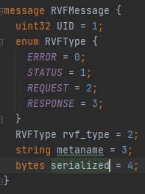
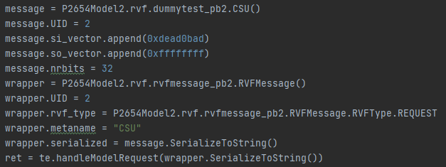
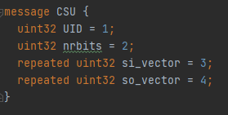
Serialization Encapsulation Example

Slide 80
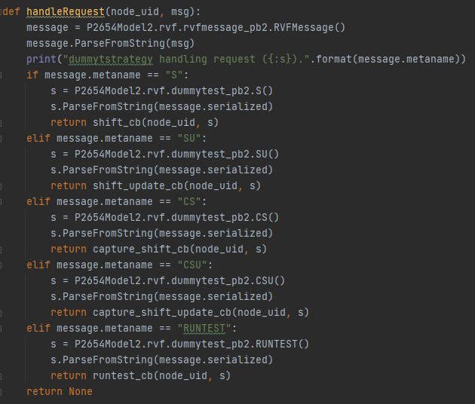
Deserialization Encapsulation Example

Slide 81
Protobuf Proposal
The use of encapsulation appears to be the best approach as it standardizes all AccessInterface messages to the same format
Overhead requires constructor of message to fill in the metaname field of the carrier message for the message type in the payload
Simpler to enforce format rules

Slide 82
Protobuf RVF Extension Mechanism
Transformation Programming Interface (TPI)
For C/C++ extensions:
Dynamic Linked Library (library.so files for Linux/OSX, library.dll for Windows)
Strictly C function definitions for handles to code in library
Message compatibility achieved by common proto buffer definition
Callbacks written in C or C++ for each message type and invoked by handler function
Callbacks decode RVF message using proto buffer code generated by protoc
EDA tool written in any language supported by Proto Buffer protoc
EDA tool uses built-in calling mechanism or SWIG for calling C TPI extension
TPI functions:
RVFResult callRequestHandler(RVFMessage message)
RVFResult callResponseHandler(RVFMessage message)
RVFResult create(TransformEngine* te, UID children_uids[]) (TBD defining this interface)
RVFResult destroy( )
RVFResult getNextRequestFromQueue( ) (May be replaced by callback to EDA)
RVfResult getNextResponseFromQueue( ) (May be replaced by callback to EDA)

Slide 83
C/C++ Dynamic Library Plugin Strategies
DDJ Plugin Framework (https://www.drdobbs.com/cpp/building-your-own-plugin-framework-part/204202899?pgno=1)
Qt Application Plugin API (https://doc.qt.io/archives/qt-4.8/plugins-howto.html)
DynObj Library (https://www.codeproject.com/Articles/20648/DynObj-C-Cross-Platform-Plugin-Objects)
Poco Shared Library Class (https://pocoproject.org/docs/Poco.SharedLibrary.html)
Gnome Modules (https://developer.gnome.org/glib/stable/glib-Dynamic-Loading-of-Modules.html)
Formal Plug-ins may be overkill for P1687.1 and P2654

Slide 84
Software Interface Generator (SWIG) Alternate to Plug-in Frameworks
SWIG is an interface compiler that connects code written in C and C++ with scripting languages
Bridge between EDA language implementation and Transform API library interface
Protobuf serialization normalizes data between EDA tools and Transform Library
.proto file generates normalization code between environments
.proto file ensures the type-correctness of callback arguments

Slide 85
Configuration Flow & JSON Based SIT Examples

Slide 86
JSON Based SIT
Attempting to capture the essence of the information required to describe a P2654 or P1687.1 transformation model
Too verbose
Problems with notation aggregating:
Domain parameterization specifications
Model structure specifications
Behavior code specifications
Message format specifications
Nesting hierarchical relationships

Slide 87
JSON Based SIT
Simplify parsing of language using JSON notation
Provide descriptions for basic building blocks
Allow for customization and user extension
Provide references to specialization code
Provide parameterization to strategy code passed from SIT to callback strategy construction
Uses freeform parameter for strategies that is difficult to validate statically (not ideal)

Slide 88
General JSON SIT Format
{
<entity name> : {
“<named field>” : <value>,
“<named field>” : “<string value>”,
“<named field>” : [ <value>, <value> ],
“<named field>” : [ “<value>”, “<value> “],
“named field>” : {
<entity name> : {
…
}
},
“transformParams” : “<transform strategy parameters>”,
“injectParams” : “<injection strategy parameters>”,
“inodeParams” : “<injection node parameters>”,
}
}

Slide 89
REGISTER
A leaf node' that represents the 1687 or JTAG TDR register modeling node.
{
“REGISTER” : {
“name” : “<node name>”,
“cproto” : “<RVF protocol>”,
“size” : <size>,
“safe” : “<safe value>”,
“transform” : “<tstrategy>”,
“inject” : “<istrategy>”,
“injectors” : [
{<injector>},
{<injector>},
],
“debug” : “<dstrategy>”,
“sticky” : false,
}
}
<node name>: instance name for the Model Node
<RVF protocol>: Message callback protocol sent by the REGISTER out of cproto Client
<size>: number of bits composing the register in decimal notation
<safe value>: the default value for the model considered a safe value for the model
<tstrategy>: The tstrategy to use (e.g., SCAN, DIGITAL, TDR). This name corresponds to the library containing the transformation callbacks defining the strategy to use.
<istrategy>: The istrategy corresponds to the library containing callbacks defining the injection strategy to use. State changes are done via injection.
<injector>: The injector corresponds to the library containing the interface to the injection source and corresponding parameters.
<dstrategy>: Optional debug process to use. The dstrategy corresponds to the library containing the debug callbacks for this node.
sticky: Used to specify the safe value corresponds to the last value it has been assigned, if set to true. Otherwise, the safe value is always used. If model is reset, the specified <safe value> is reloaded as the safe value.

Slide 90
INSTANCE
A leaf node' that represents the instantiation of a module at the point of insertion (as for any other child nodes).
{
“INSTANCE” : {
“name” : “<node name>”,
“sit” : “<SIT file>”
},
“INSTANCE” : {
“name” : “<node name>”,
“factory” : “<factory name>”
}
}
<node name>: instance name for the Model Node
<SIT file>: The name or path of a SIT file with .sit extension. It must be enclosed between double quotes if filename contains spaces or reserved keywords.
<factory name>: identify a model factory registered by a plugin

Slide 91
CHAIN
A hierarchical node' that represents a chained hierarchy. This node models a structure of multiple segments as a hierarchy of sibling children nodes of the same order. Cardinality order of the modules in the list is important. Modules are specified with the children keyword.
{
“CHAIN” : {
“name” : “<node name>”,
“cproto” : “<RVF protocol>”,
“hproto” : “<RVF protocol>”,
“transform” : “<tstrategy>”,
“inject” : “<istrategy>”,
“injectors” : [
{<injector>},
{<injector>},
], “debug” : “<dstrategy>”,
“visible” : false,
“children” : [
{
<child node>,
<child node>
}]
}
}
<node name>: instance name for the Model Node
<RVF protocol>: Message callback protocol used by the corresponding Client and Host Interfaces
<tstrategy>: Transformation strategy to use (e.g., SCAN, JTAG, I2C, SPI). This name corresponds to the library containing the transformation callbacks defining the strategy to use.
<istrategy>: The istrategy corresponds to the library containing callbacks defining the injection strategy to use. State changes are done via injection.
<injector>: The injector corresponds to the library containing the interface to the injection source and corresponding parameters.
<dstrategy>: Optional debug process to use. The strategy corresponds to the library containing the debug callbacks for this node.
<visible>: Attribute to specify whether node is visible in the path specification or not. Default is false, not visible.
<child node>: One or more nodes defining a hierarchical sub-tree of this CHAIN.

Slide 92
LINKER
A hierarchical node' that represents a selectable chained hierarchy. This node models a structure of multiple segments as a hierarchy of sibling children nodes that may be present or missing from the path. Order of the modules in the list is important. Modules are specified with the children keyword.
{
“LINKER” : {
“name” : “<node name>”,
“cproto” : “<RVF protocol>”,
“hproto” : “<RVF protocol>”,
“transform” : “<tstrategy>”,
“inject” : “<istrategy>”,
“injectors” : [
{<injector>},
{<injector>},
],
“debug” : “<dstrategy>”,
“visible” : false,
“selector” : “<selector>”,
“control” : [ “<control node>”, “<control node>”],
“derivations” : <count>,
“parameters” : “<parameters>”,
“children” : [ {
<child node>,
<child node>
} ]
}
}
<node name>: instance name for the Model Node
<RVF protocol>: Message callback protocol used by the corresponding Client and Host Interfaces
<tstrategy>: Transformation strategy to use (e.g., SCAN, JTAG, I2C, SPI). This name corresponds to the library containing the transformation callbacks defining the strategy to use.
<istrategy>: The istrategy corresponds to the library containing callbacks defining the injection strategy to use. State changes are done via injection.
<injector>: The injector corresponds to the library containing the interface to the injection source and corresponding parameters.
<dstrategy>: Optional debug process to use. The strategy corresponds to the library containing the debug callbacks for this node.
<visible>: Attribute to specify whether node is visible in the path specification or not. Default is false, not visible.
<selector>: A string identifying the callback set for Linker (e.g., “Binary”, “Binary_noidle”, “One_Hot”, “One_Hot_noidle”, “N_Hot”, “N_Hot_noidle”, {“Table”: [<ordered list of values>]}, or {“Custom” : “<custom strategy>”}), where <custom strategy names a library containing the customized selection callbacks.
<control node>: A list of register or slice of a register used to define the bits used to control the selection. <control>s are concatenated to obtain the Virtual Register selecting the linker.
<child node>: One or more nodes defining a hierarchical sub-tree of this LINKER.
<parameters>: String containing <selector> specific parameters.

Slide 93
MODELPOINT
A leaf node' that represents a translator between the software model and external tools or protocol formats. This node references the strategy to be used to bridge the tooling with the model tree.
{
“MODELPOINT” : {
“name” : “<node name>”,
“cproto” : “<RVF protocol>”,
“transform” : “<tstrategy>”,
“debug” : “<dstrategy>”,
“visible” : false,
“transformParams” : “<parameters>”
}
}
<node name>: instance name for the Model Node
<RVF protocol>: Message callback protocol sent by the MODELPOINT out of cproto Client
<tstrategy>: Translation strategy to use . This name corresponds to the library containing the translation methods defining the strategy to use for bridging external resources with the model tree.
<dstrategy>: Optional debug process to use. The strategy corresponds to the library containing the debug callbacks for this node.
<visible>: Attribute to specify whether node is visible in the path specification or not. Default is false, not visible.
<parameters>: String containing <transform strategy> specific parameters.

Slide 94
CUSTOM
A model node' that represents the customizable node of a tree where none of the primitive node types describe the behavior of the node. The children represent a list of dissimilar sub-trees coordinated for a test.
{
“CUSTOM” : {
“name” : “<node name>”,
“cproto” : “<RVF protocol>”,
“hproto” : “<RVF protocol>”,
“transform” : “<tstrategy>”,
“inject” : “<istrategy>”,
“injectors” : [
{<injector>},
{<injector>},
], “debug” : “<dstrategy>”,
“visible” : true,
“selector” : “<selector>”,
“control” : [ “<control node>”, “<control node>”],
“parameters” : “<parameters>”,
“children” : [
{
<child node>,
<child node>
}]
}
}
<node name>: instance name for the Model Node
<RVF protocol>: Message callback protocol used by the corresponding Client and Host Interfaces
<tstrategy>: Transformation strategy to use (e.g., SCAN, JTAG, I2C, SPI). This name corresponds to the library containing the transformation callbacks defining the strategy to use.
<istrategy>: The istrategy corresponds to the library containing callbacks defining the injection strategy to use. State changes are done via injection.
<injector>: The injector corresponds to the library containing the interface to the injection source and corresponding parameters.
<dstrategy>: Optional debug process to use. The strategy corresponds to the library containing the debug callbacks for this node.
<visible>: Attribute to specify whether node is visible in the path specification or not. Default is false, not visible.
<selector>: A string identifying the callback set for Linker (e.g., “Binary”, “Binary_noidle”, “One_Hot”, “One_Hot_noidle”, “N_Hot”, “N_Hot_noidle”, {“Table”: [<ordered list of values>]}, or {“Custom” : “<custom strategy>”}), where <custom strategy names a library containing the customized selection callbacks.
<control node>: A list of register or slice of a register used to define the bits used to control the selection. <control>s are concatenated to obtain the Virtual Register selecting the customized linker.
<parameters>: String containing node specific parameters.
<child node>: One or more nodes defining a hierarchical sub-tree of this CUSTOM node.

Slide 95
ROOT
A model node' that represents the top node of a tree where CONTROLLER nodes are coordinated as a single unit. The children represent a list of dissimilar sub-trees, as CONTROLLERS, coordinated for a test.
{
“ROOT” : {
“name” : “<node name>”,
“hproto” : “<RVF protocol>”,
“transform” : “<tstrategy>”,
“debug” : “<dstrategy>”,
“visible” : true,
“children” : [
{
<child node>,
<child node>
}]
}
}
<node name>: instance name for the Model Node
<RVF protocol>: Message callback protocol used by the corresponding Client and Host Interfaces
<tstrategy>: Transformation strategy to use (e.g., SCAN, JTAG, I2C, SPI). This name corresponds to the library containing the transformation callbacks defining the strategy to use.
<dstrategy>: Optional debug process to use. The strategy corresponds to the library containing the debug callbacks for this node.
<visible>: Attribute to specify whether node is visible in the path specification or not. Default is false, not visible.
<child node>: One or more nodes defining a hierarchical sub-tree of this ROOT node.

Slide 96
CONTROLLER
A model node' that represents the top node of a tree where event messages are folded into hardware device driver calls. The children represent a list of similar sub-trees coordinated for a test and controlled by the CONTROLLER.
{
“CONTROLLER” : {
“name” : “<node name>”,
“hproto” : “<RVF protocol>”,
“transform” : “<tstrategy>”,
“debug” : “<dstrategy>”,
“visible” : true,
“children” : [
{
<child node>,
<child node>
}]
}
}
<node name>: instance name for the Model Node
<RVF protocol>: Message callback protocol used by the corresponding Client and Host Interfaces
<tstrategy>: Transformation strategy to use (e.g., SCAN, JTAG, I2C, SPI). This name corresponds to the library containing the transformation callbacks defining the strategy to use.
<dstrategy>: Optional debug process to use. The strategy corresponds to the library containing the debug callbacks for this node.
<visible>: Attribute to specify whether node is visible in the path specification or not. Default is false, not visible.
<child node>: One or more nodes defining a hierarchical sub-tree of this CONTROLLER node.

Slide 97
JSON Based SIT for JTAGBoard1
{
"ROOT" : {
"name": "JTAGBoard1",
"hproto": "JTAG",
"transform": "JTAGBoard1",
"visible": false,
"children": [
{
"CONTROLLER": {
"name": "JTAGControllerAssembly",
"hproto": "JTAG",
"transform": "JTAGControllerAssembly",
"visible": false,
"children": [
{
"CHAIN": {
"name": "JTAGChain",
"transform": "JTAGChain",
"inject": "",
"injectors": [
],
"visible": true,
"children": [
{
"LINKER": {
"name": "U1",
"transform": "TAPTransform",
"visible": true,
"selector": {
"Custom": "TAPSelector"
},
"control": [],
"derivations": 2,
"children": [
{
"REGISTER": {
"name": "IR",
"size": 8,
"safe": "0xFF",
"transform": "TDRTransform",
"inject": "TDRInject",
"injectors": [
{
"TDRio": "size=8 safe=0xFF"
}
],
"sticky": false,
"visible": true
},

Slide 98
JSON Based SIT for JTAGBoard1
"LINKER": {
"name": "ScanMux",
"transform": "TAPMux",
"visible": false,
"selector": {
"Table": [
{
"0xFF": "BYPASS",
"0x00": "BSR",
"0x01": "BSR"
}
]
},
"control": [
"JTAGChain.U1.IR"
],
"derivations": 2,
"children": [
{
"REGISTER": {
"name": "BYPASS",
"cproto": "JTAG",
"size": 1,
"safe": "0",
"transform": "TDRTransform",
"inject": "TDRInject",
"injectors": [
{
"TDRio": "size=1 safe=0"
}
],
"sticky": false,
"visible": true
}
},

Slide 99
JSON Based SIT for JTAGBoard1
{
"REGISTER": {
"name": "BSR",
"cproto": "JTAG",
"size": 32,
"safe": "0xFFFFFFFF",
"transform": "TDRTransform",
"inject": "TDRInject",
"injectors": [
{
"TDRio": "size=32 safe=0xFFFFFFFF"
}
],
"sticky": true,
"visible": true
}
}
]
}
}
]
}
}
]
}
}
]
}
},

Slide 100
JSON Based SIT for JTAGBoard1
{
"CONTROLLER": {
"name": "GPIOController",
"hproto": "GPIO",
"transform": "GPIOControllerAssembly",
"visible": false,
"children": [
{
"REGISTER": {
"name": "GPIO1",
"size": 32,
"safe": "0",
"transform": "GPIOTransform",
"inject": "GPIOInject",
"injectors": [
{
"GPio": "size=32 safe=0"
}
],
"sticky": false,
"visible": true
}
}
]
}
}
]
}
}

Slide 101
Additional Material

Slide 102
Signal Examples
Qt5 Signals & Slots (https://doc.qt.io/qt-5/signalsandslots.html)
Signals and slots are used for communication between objects. The signals and slots mechanism is a central feature of Qt and probably the part that differs most from the features provided by other frameworks. Other toolkits achieve this kind of communication using callbacks.
A signal is emitted when a particular event occurs.
Qt's widgets have many predefined signals, but we can always subclass widgets to add our own signals to them.
A slot is a function that is called in response to a particular signal.
The signature of a signal must match the signature of the receiving slot.
Signals are emitted by objects when they change their state in a way that may be interesting to other objects.
The signal does not know or care whether anything is receiving the signals it emits. This is true information encapsulation, and ensures that the object can be used as a software component.
You can connect as many signals as you want to a single slot, and a signal can be connected to as many slots as you need.

Slide 103
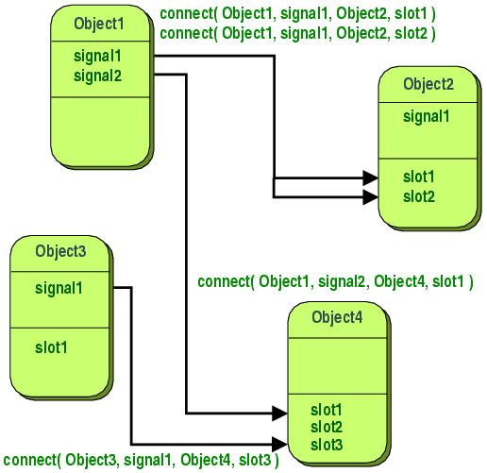
Signal Examples
Qt5 Signals & Slots (https://doc.qt.io/qt-5/signalsandslots.html)

Slide 104
Event Examples
Qt5 QEvent (https://doc.qt.io/qt-5/qevent.html, https://doc.qt.io/qt-5/eventsandfilters.html)
The QEvent class is the base class of all event classes. Event objects contain event parameters.
Represent things that have happened either within an application or as a result of outside activity that the application needs to know about.
Events can be received and handled by any instance of a QObject subclass, but they are especially relevant to widgets.

Slide 105
Event Examples
Qt5 QEvent (https://doc.qt.io/qt-5/qevent.html, https://doc.qt.io/qt-5/eventsandfilters.html)
Delivered to a particular instance of QObject (or one of its subclasses) by calling its event() function. This function does not handle the event itself; based on the type of event delivered, it calls an event handler for that specific type of event, and sends a response based on whether the event was accepted or ignored.
Most event types have special classes, notably QResizeEvent, QPaintEvent, QMouseEvent, QKeyEvent, and QCloseEvent. Each class subclasses QEvent and adds event-specific functions (e.g., size()) to enable widgets to discover how their dimensions have been changed.

Slide 106
Event Examples
Qt5 QEvent (https://doc.qt.io/qt-5/qevent.html, https://doc.qt.io/qt-5/eventsandfilters.html)
Event types:
Spontaneous events are generated by the window system. They are put in a system queue and processed one after the other by the event loop.
Posted events are generated by Qt or by the application. They are queued by Qt and processed by the event loop.
Sent events are generated by Qt or by the application, but they are sent directly to the target object.

Slide 107
Signal, Slots, Callbacks
Qt5 Signal/Slots vs. Callbacks (https://doc.qt.io/qt-5/signalsandslots.html)
A signal is emitted when a particular event occurs.
A slot is a function that is called in response to a particular signal.
Other toolkits achieve this kind of communication using callbacks.
A callback is a pointer to a function, so if you want a processing function to notify you about some event you pass a pointer to another function (the callback) to the processing function.
The processing function then calls the callback when appropriate.
While successful frameworks using this method do exist, callbacks can be unintuitive and may suffer from problems in ensuring the type-correctness of callback arguments.

Slide 108
Generalized P2654 SW Model
Top Level (Where SW model meets HW)
SPI_to_I2C Bridge
JTAG_TOP
GPIO_TOP
SPI_TOP
ModelPoint (adapter)
ModelPoint (adapter)
ModelPoint (adapter)
ModelPoint (adapter)
Transformation Node (e.g., LINKER, SCANMUX, BRIDGE, etc.)
ModelPoint (adapter)
I2C Model
ScanReg Model
DataReg Model
Transformation Node (e.g., LINKER, SCANMUX, BRIDGE, etc.)
GPIO Model
SPI Model
ModelPoint (adapter)
ModelPoint (adapter)
ModelPoint
(adapter)
ModelPoint (adapter)
ModelPoint (adapter)
ModelPoint (adapter)
ModelPoint Proxy (RPC Extension adapter)
GPIO Model
Custom Model
JTAG Model
I2C Model
SPI Model
SCAN Model
Sub-Assembly (Top Level)
Sub-Assembly (Top Level)

Slide 109
Simplified AccessInterface and Node Diagram
CLIENT INTERFACE
TRANSFORMATION ENGINE
(Model Node)
HOST INTERFACE
REQUEST
RESPONSE
ACCESS INTERFACE (edges of graph)
Transformations in P2654 are nothing more than a specialized Transformation Engine that may or may not be P1687.1 compliant
CLIENT INTERFACE
TRANSFORMATION ENGINE
(Model Node)
HOST INTERFACE
3/23/2021

Slide 110
Strategy to Bridge Between P2654 and non-P2654 Domains
ModelPoint (adapter) is a non-visible node in the topology path
ModelPoint (adapter) translates non-P2654 grammars to P2654 grammar
Translation interface between external tooling and the software model message scheme
Ensures valid RVF messages to the software model
Provides hook for domain languages applicable to hierarchical level to manipulate branch directly
Provides hook for tooling applicable to hierarchical level to manipulate branch directly
Unifies vector interaction from multiple sources for a given hierarchical level
ModelPoint
(adapter)
ModelPoint
(adapter)
ModelPoint
(adapter)
Custom Model
Device EDA Tool
SCAN Model
ModelPoint
(adapter)
ModelPoint
(adapter)
ModelPoint
(adapter)
IEEE 1687 Application PDL IF
IEEE 1149.1 Application PDL IF
I²C Message Based Tooling
ModelPoint
(adapter)
ModelPoint
(adapter)
ModelPoint
(adapter)
SVF Player
JTAG Model
ScanReg Model
DataReg Model
Notes:
Custom Model: Any modeling or tooling providing retargeting or vectors for specific level that does not conform to the P2654 RVF grammar specifications and messaging format defined by the native software model for that level.
Device EDA Tool: A communications interface with a device EDA tool that provides interactive vector information for a device interface that does not conform to the P2654 RVF grammar specifications and messaging format defined by the native software model for that level.
SCAN Model: A communications interface with tooling that provides vectors for an IEEE 1687 network branch at a given hierarchical level that does not conform to the P2654 RVF grammar specifications and messaging format defined by the native software model for that level. This could be an interface from the system model application to alter the state of a 1687 scan network.
IEEE 1687 Application PDL IF: The Application PDL Interface is communications interface with tooling that provides vectors for an IEEE 1687 network branch at a given hierarchical level that does not conform to the P2654 RVF grammar specifications and messaging format defined by the native software model for that level. This is used by interactive PDL applications.
IEEE 1149.1 Application PDL IF: The Application PDL Interface is communications interface with tooling that provides vectors for an IEEE 1149.1-2013 network branch at a given hierarchical level that does not conform to the P2654 RVF grammar specifications and messaging format defined by the native software model for that level. This is used by interactive PDL applications.
I²C Message Based Tooling: A communications interface with tooling that provides I2C commands for a specific network branch or device interface at a given hierarchical level that does not conform to the P2654 RVF grammar specifications and messaging format defined by the native software model for that level.
SVF Player + JTAG Model: A communications interface with tooling that provides vectors from an SVF Player and EDA tooling for an IEEE 1149.1 JTAG network branch or device at a given hierarchical level that does not conform to the P2654 RVF grammar specifications and messaging format defined by the native software model for that level.
ScanReg Model: An interface from the system model application used to alter the state of a particular ScanRegister in a 1687 network.
DataReg Model: An interface from the system model application used to alter the state of a particular DataRegister in a 1687 network.

Slide 111
Generalized P2654 SW Model
Modeling part of Application
Top Level (Where SW model meets HW)
gRPC_TOP
SPI_to_I2C Bridge
ModelPoint Proxy (RPC Extension adapter)
JTAG_TOP
I2C_TOP
GPIO_TOP
SPI_TOP
ModelPoint (adapter)
ModelPoint (adapter)
ModelPoint (adapter)
Transformation Node (e.g., LINKER, SCANMUX, BRIDGE, etc.)
ModelPoint (adapter)
Sub-Assembly (Top Level)
I2C Model
Transformation Node (e.g., LINKER, SCANMUX, BRIDGE, etc.)
Sub-Assembly (Top Level)
I2C Model
GPIO Model
SPI Model
Transformation Node
(JTAG2GPIO Bridge)
ModelPoint (adapter)
ModelPoint
(adapter)
ModelPoint (adapter)
ModelPoint (adapter)
ModelPoint (adapter)
Transformation Node
(JTAG2I2C Bridge)
ModelPoint (adapter)
Custom Model
JTAG Model
SCAN Model
ScanReg Model
DataReg Model
ModelPoint (adapter)
I2C Model
GPIO Model
Notes:
ModelPoint (adapter) is the conversion point between different tool domains.

